Slide 1
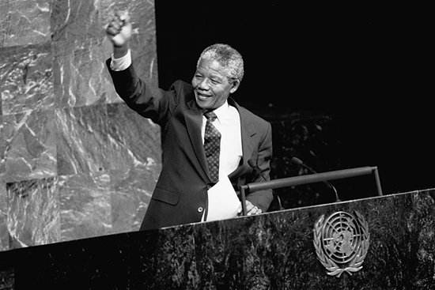
Unit 5
Nelson Mandela
-- a modern hero

Slide 2

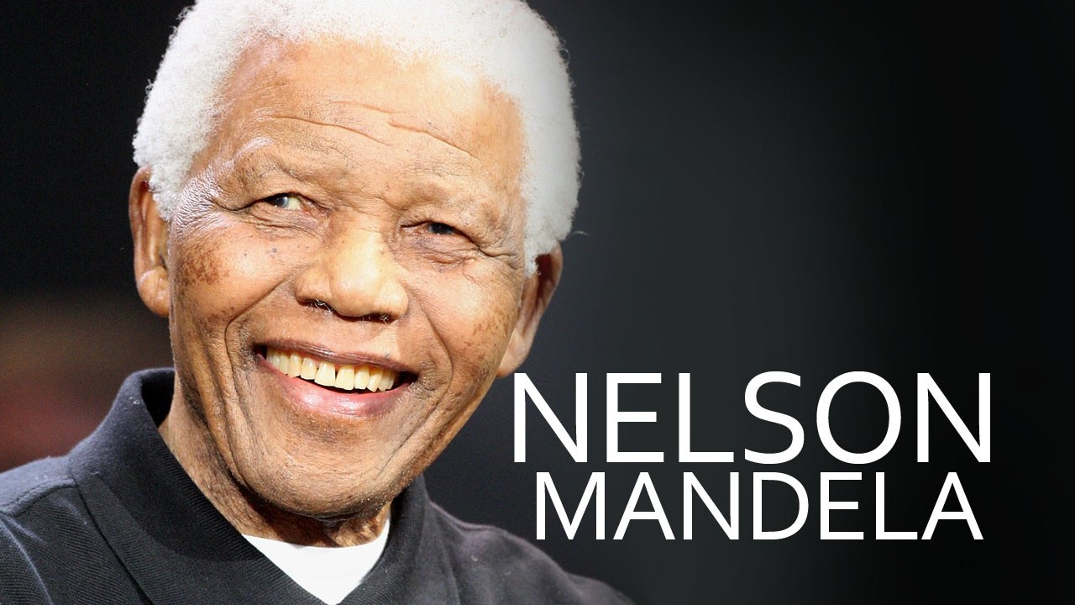
Now let us talk about the great person Nelson Mandela.

Slide 3
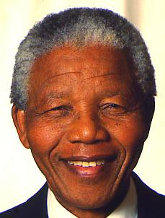
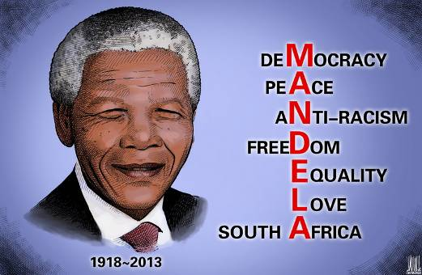
the first black president of South Africa

Slide 4

Quotes From Nelson Mandela

Slide 5
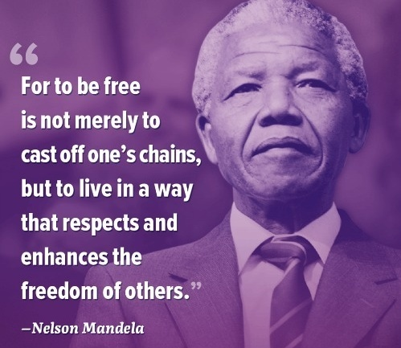

Slide 6

Elia's Story

Slide 7



1. Read the passage carefully and decide whether they are true or false and give a reason.
1. Elias went to see Nelson Mandela when he was in trouble.
2. Elias left school because the school was too far from his home.
3. Nelson Mandela helped him keep his job.

Slide 8
4. Elias trusted Nelson Mandela and he joined the ANC Youth League.
5. Elias was willing to blow up government buildings.
6. Nelson Mandela thought violence was a good way to help black people.

Slide 9
2. Answer the following questions.
1) Why did Elias visit Nelson Mandela?
Because he needed legal help. He was not legally allowed to work without a passbook. He did not have one because he was not born in Johannesburg. Nelson Mandela was able to help him get the passbook.

Slide 10
2) What did Mandela do to help black
people?
Mandela helped black people by offering guidance to them on legal problems. This prevented them from being badly treated by the government.

Slide 11
3) What was Elias’s attitude towards the unfair situation black people faced? How do you know?
He felt upset/angry. He tells us in the story that black people could not choose where to live, his job or his homeland outside the city.

Slide 12
4) Why did Nelson Mandela turn to violence to make black and white
people equal?
Because he felt there was no other way of changing this unfair situation.

Slide 13
3. Discuss in groups and explain the quotes in your own words.
1.“The last thirty years have seen the greatest number of laws stopping our rights and progress, until today we have reached a stage where we have almost no rights at all.” Explain the meaning in your own words.

Slide 14
In the past 30 years, more and more laws were passed to take away our rights and stop our progress. We were being given fewer and fewer rights. Today we have almost lost all our rights.

Slide 15
2. “... we were put into a position in which we had either to accept we were less important, or fight the government. We chose to attack the laws. We first broke the law in a way which was peaceful; when this was not allowed ... only then did we decide to answer violence with violence.”

Slide 16
We had two choices: One was to accept the fact that we were not so important as the white; the other was to fight for our rights. Of the two choices, we chose to fight against the law. At first, we broke the law in a peaceful way. We had no choice but to fight with violence when we were not allowed to solve the problem peacefully.

Slide 17

Fill in the blanks to finish the
Summary of the text and then try to
retell it.

Slide 18
Elias had to leave school at an early age because his family couldn’t continue __________ the school fees and bus fare. Later he found a job in a gold
mine, but he was worried about ________ he would become ____________ because he had no passbook. So he ________ Mandela, the black lawyer, for _________ on legal problems. Mr. Mandela told him ______ to do and he became ______________ about his future. Elias joined his organization and helped him ___________ some government buildings. Elias was happy to help Mandela because he knew Mandela would help them ________ their dreams of _________ black and white people ______.
to pay
whether
out of work
turned to
guidance
what
more hopeful
blow up
achieve
making
equal

Slide 19


